Slide 1
Hermes Microvision, Inc. Presents
Application Development & Optimization

Slide 2
Working Flow
Wafer & Recipe Info
Topo Contrast
LE
Mat Contrast
Analyzing DOI
Current
VC
Pixel size
Testing Condition
Good resolution
Stable
Average
General requirements
uniform
No.5 biasing
DOI Imaging
On Device
Scan direction
On Dummies
Setup recipe & Test
Pre-scan
On Edge Dice
Tuning Condition
On DOI
Pre-Flood
Optimizing Insp
Threshold
Device status control
Sensitivity
Reviewing DOI
VC Balance
BGB
ADC/reporting
DBDB

Slide 3
Wafer & Recipe Information
Wafer & Recipe Info
Topo Contrast
LE
Mat Contrast
Analyzing DOI
Current
VC
Pixel size
Testing Condition
Good resolution
Stable
Average
General Imaging
uniform
No.5 biasing
DOI Imaging
On Device
Scan direction
On Dummies
Setup recipe & Test
Pre-scan
On Edge Dice
Tuning Condition
On DOI
Pre-Flood
Optimizing Insp
Threshold
Device status control
Sensitivity
Reviewing DOI
VC Balance
BGB
ADC/reporting
DBDB

Slide 4
Wafer & Recipe Information
Design rule, device, Layer, DOI and signature (if available) …
Top-layer info: layout, topographical info, material info, feature size, …
Sub-layer info: layout, dielectric material and connection
Schematics of cross-section, root cause of DOI
Recipe info: such like die origin, die size, reticle size, center die, edge exclusion, AOI, sampling plan, etc.
requirements: Pixel size, Throughput, Sensitivity, False Rate, R&R, ADC Accuracy/Purity, etc.
Others

Slide 5
Example -- 90nm SRAM Contact WCMP
Lay and sub-layer layout
Cross-section view
DOI – CT under-etch
Poly gate & P+/N-well
(square cont.)
P+/N-well
N+/P-well
Poly gate
NiSiX
CT AEI
CT WCMP
Film 1
x000A Poly Height
x000A ILD
W
x000A TEOS
x000A SACVD
STI
n⁺
n⁺
USG
p⁺
p⁺
P-Well
N-Well
P-Epi
P-Wafer

Slide 6
What kind of DOI?
Wafer & Recipe Info
Topo Contrast
LE
Mat Contrast
Analyzing DOI
Current
VC
Pixel size
Testing Condition
Good resolution
Stable
Average
General Imaging
uniform
No.5 biasing
DOI Imaging
On Device
Scan direction
On Dummies
Setup recipe & Test
Pre-scan
On Edge Dice
Tuning Condition
On DOI
Pre-Flood
Optimizing Insp
Threshold
Device status control
Sensitivity
Reviewing DOI
VC Balance
BGB
ADC/reporting
DBDB

Slide 7
DOI Classifications
Location DOI Type Image Type DOI Examples
Foreign particles, Process residues, bump, dent, Pattern/CD change, …
Physical
Topo Contrast
Mat Contrast
chemical mark, etch/CMP remain, growth/deposition/implant missing, …
Surface
Electrical
VC
Short/Bridge/Broken (conductive)…
Physical
Mat Contrast
void, missing, … (limited capability for EBI)
DOI
Buried
Electrical
VC
Gate/S/D Leak, CT short/open, residues, piping
Physical
Mat Contrast
Footing, pitting, residue
HAR
Electrical
VC
CT under/over etch, residue, piping

Slide 8
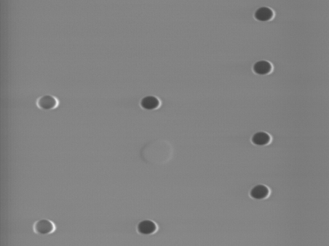
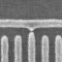
DOI-Surface-Physical-TC
General Guidelines
Extraction mode
Hi-LE in favor of edge signal (contrast)
Lo-LE in favor of material contrast
Reasonable Ip and pixel size for proper resolution
Location DOI Type Image Type
Physical
Topo Contrast
DOI
Mat Contrast
Surface
Electrical
VC

Slide 9
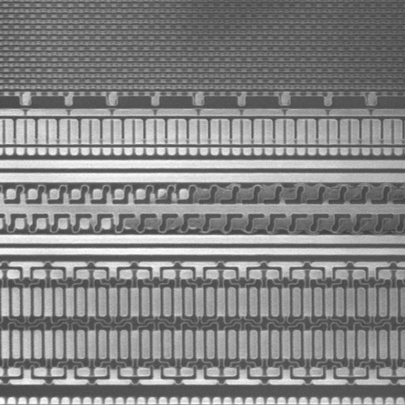
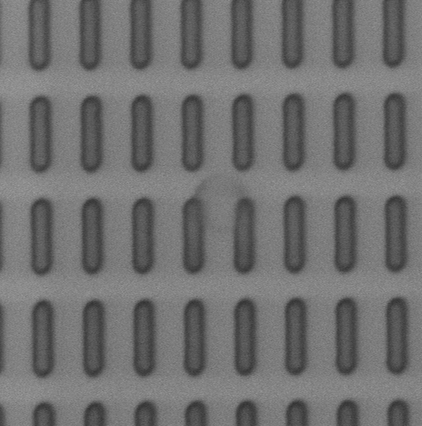

DOI-Surface-Physical-MC
General Guidelines
Extraction mode
Positive Pre-flood or pre-scan to boost contrast differences
Lo-LE or Hi-LE for optimal contrast.
Reasonable Ip and pixel size for proper resolution
Location DOI Type Image Type
Physical
Topo Contrast
DOI
Surface
Mat Contrast
Electrical
VC
Hi LE

Slide 10
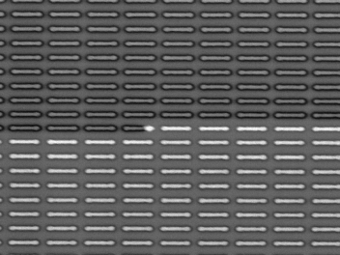

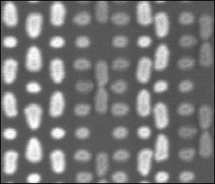
DOI-Surface-Electrical-VC
General Guidelines
Positive mode or negative mode
Proper scan direction and/or average modes impose different charging rate, thus VC may differs
Proper charging rate against discharging rate is the key
Trade off for charging control may frequently apply.
Pre-scan or post scan may help VC enhancement or charging control
Location DOI Type Image Type
Physical
Topo Contrast
Mat Contrast
DOI
Surface
Electrical
VC

Slide 11
DOI-Subsurface-Physical-MC
Guidelines
Limited by SE’s escape depth, not a typical application for EBI
Location DOI Type Image Type
Physical
Mat Contrast
DOI
Buried
(CMP/Cap)
Electrical
VC
1kEV
1.5kEV

Slide 12
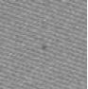
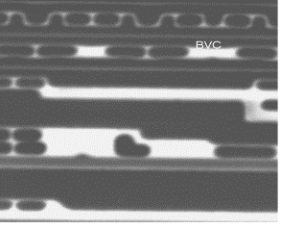
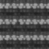
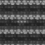
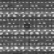
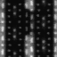
DOI-Subsurface-Electrical-VC
Guidelines
Positive (+) mode: Extraction + Lo-LE; Positive flood/pre-scan helps
Negative (-) mode: Retarding or extraction + Hi-LE; negative flood/pre-scan helps
For WCMP,
(+) mode DOI: N+/Pwell leak, P+/Nwell Open; Gate Leak
(-) mode DOI: P+/Nwell leak, N+/Pwell Open; Gate Leak
For Caped CMP
(-) mode only, DOI Open&Leak,
Location DOI Type Image Type
Physical
Mat Contrast
DOI
Buried
(CMP/Cap)
Electrical
VC

Slide 13
DOI-HAR-Physical-MC
Guidelines
Limited by resolution, not a typical application for EBI
Location DOI Type Image Type
Physical
Mat Contrast
DOI
HAR
Electrical
VC

Slide 14
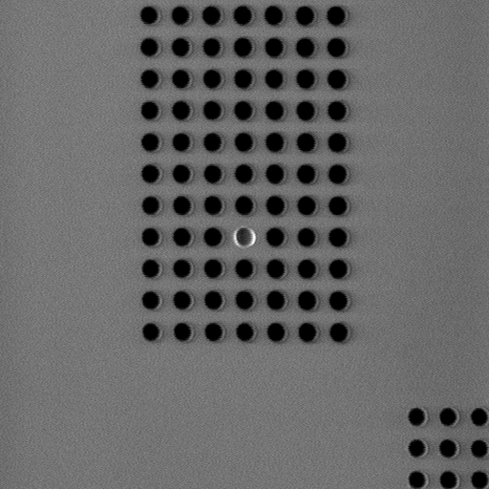
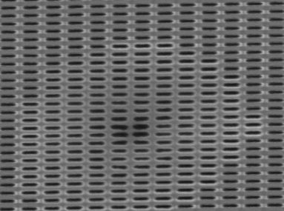

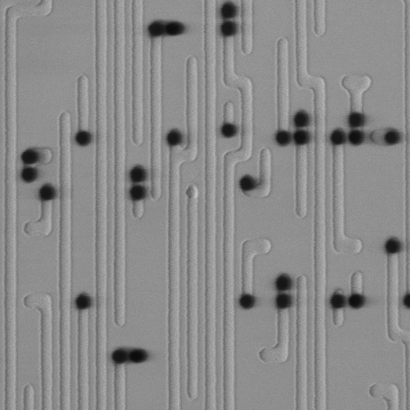
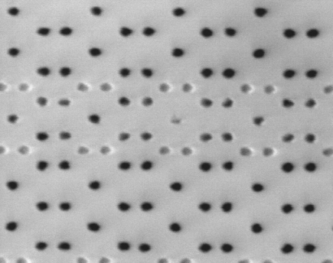
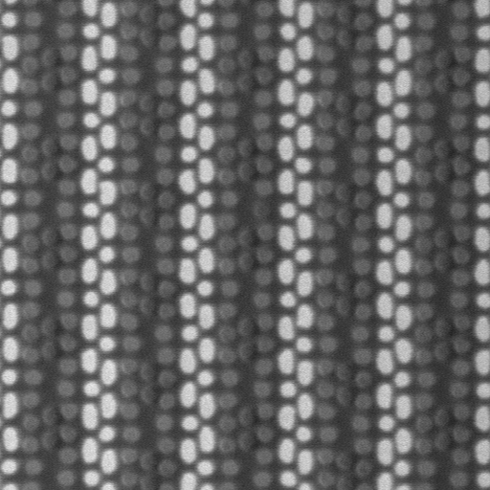
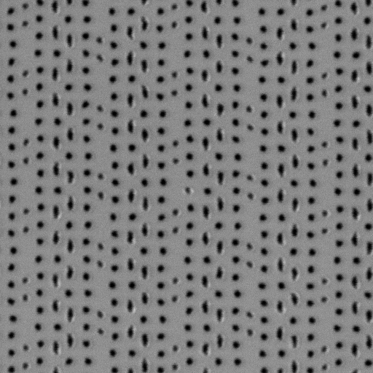
DOI-HAR-Physical/Electrical-MC/VC
Location DOI Type Image Type
Guidelines
Normally extraction, retarding if VC reverse.
Normally Lo-LE, slightly Hi-LE if VC reverse.
Flood may enhance VC, must if VC reverse.
Physical
Mat Contrast
DOI
HAR
(w/o CMP)
Electrical
VC

Slide 15
Testing Conditions
Wafer & Recipe Info
Topo Contrast
LE
Mat Contrast
Analyzing DOI
Current
VC
Pixel size
Testing Conditions
Good resolution
Stable
Average
General requirements
uniform
No.5 biasing
DOI check
On Device
Scan direction
On Dummies
Setup recipe & Test
Pre-scan
On Edge Dice
Tuning Condition
On DOI
Pre-Flood
Optimizing Insp
Threshold
Sensitivity
Reviewing DOI
VC Balance
BGB
ADC/reporting
DBDB

Slide 16
General Requirements
Image Quality
Affected by many factors (stigmator, focus, LE, Ip, Apt, GL, layers structure, density, materials, …)
Reasonable resolution good for DOI
High Contrast (by condition)
Uniform over FOV
Image Stable?
Focus
Distortion free
No drift from scan to scan
No significant GL variation from scan to scan

Slide 17
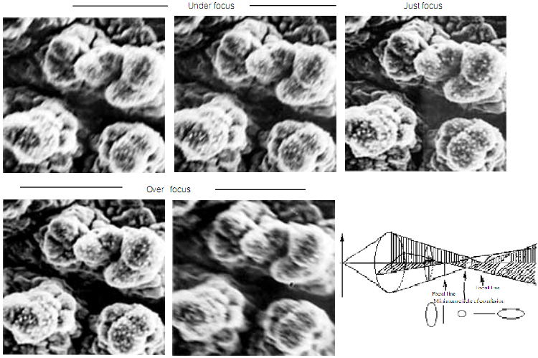
Image Quality -- Astigmatism Correction

Slide 18
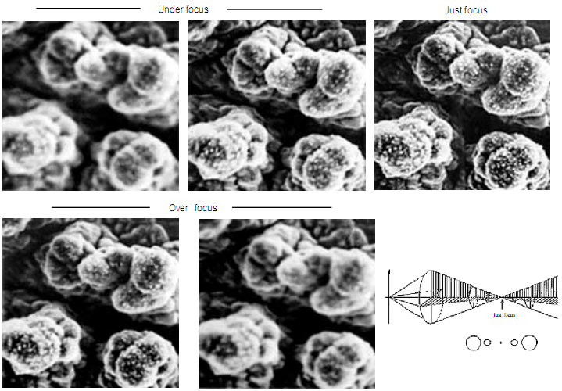
Image Quality -- Focus

Slide 19
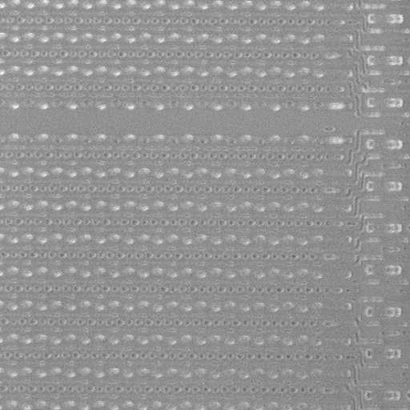
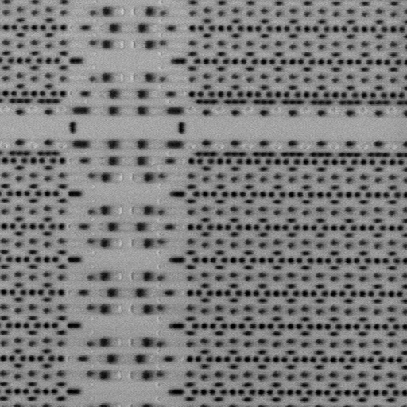
Image Quality – High Contrast

Slide 20
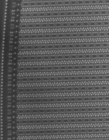
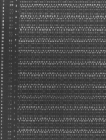
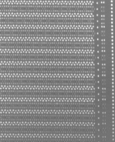
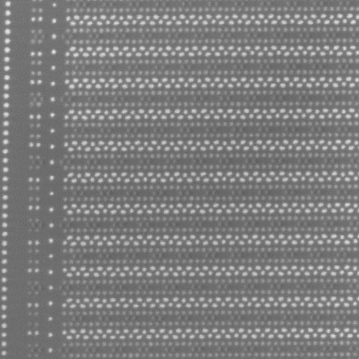
Stable Image -- Control Distortion
By LE
L.E=200
L.E=500
LE increased
L.E=800
L.E=1000

Slide 21
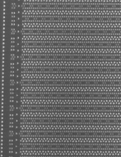
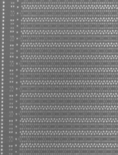
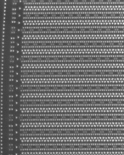
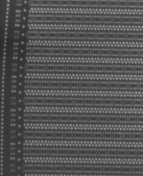
Stable Image -- Control Distortion
By Ip
Ip reduced

Slide 22
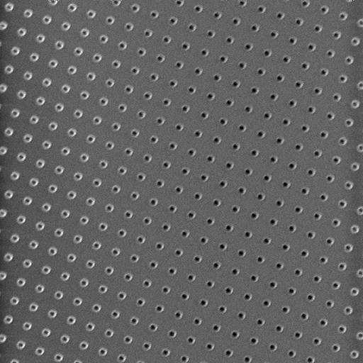

Stable Image? -- Uniform Charging
Marginal condition shows transition from positive to negative mode
Keep away from this transition by any means of
varying LE, Ip, pixel size, average, etc, or
Increasing retarding or extraction, or
Pre-scan, flooding, etc
Reduce current

Slide 23
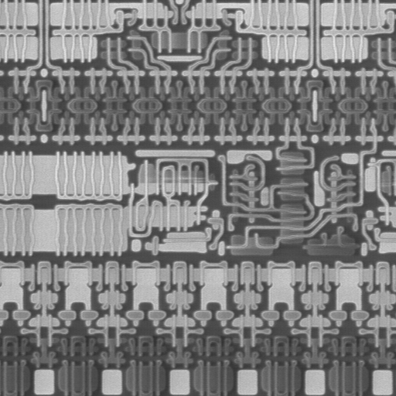
Stable Image? –charge Artifacts
Over charge reach breakdown -> Line artifact , need charge controls

Slide 24
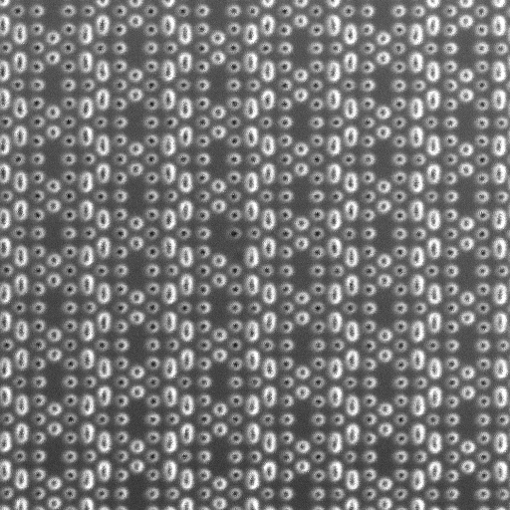
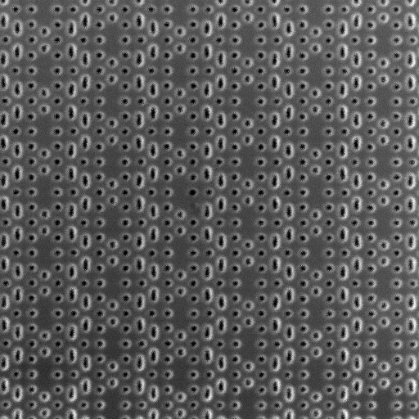


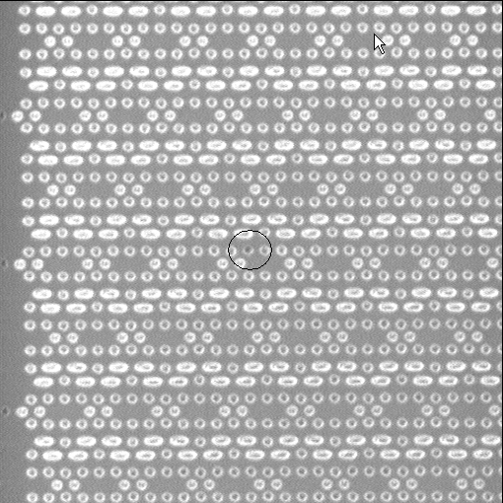
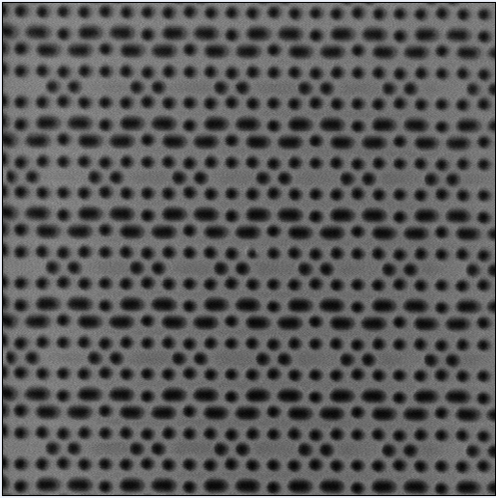
Stable Image? -- Stable GL
1st scan
2nd scan
3nd scan
N^{th} scan
Case 1 – slow charge up
GL ramp up/down from scan to scan
Equilibrium not reached within one scan
Need pre-scan or flood to accelerate
Before flood
After flood

Slide 25
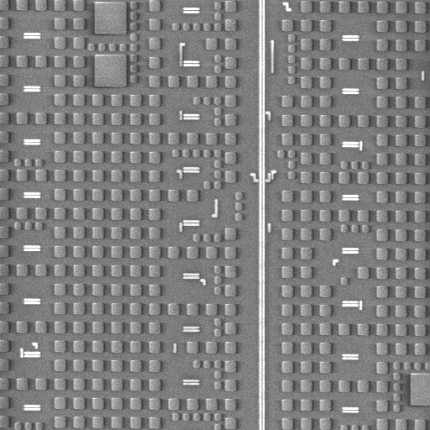
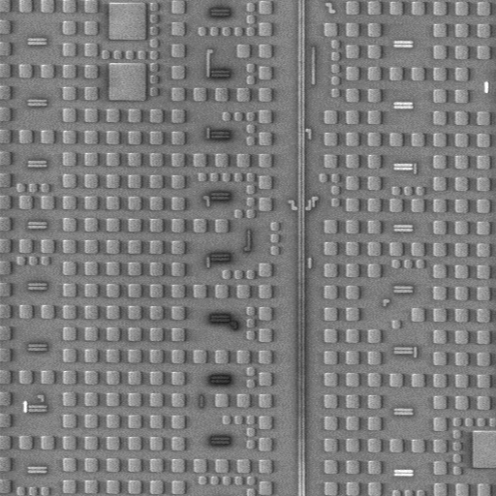
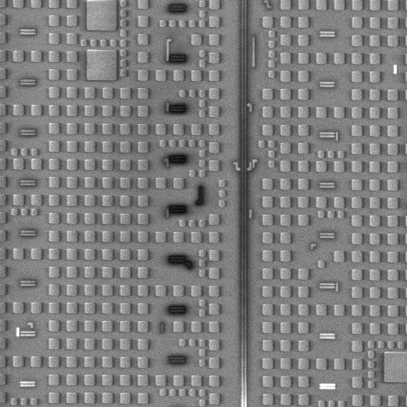
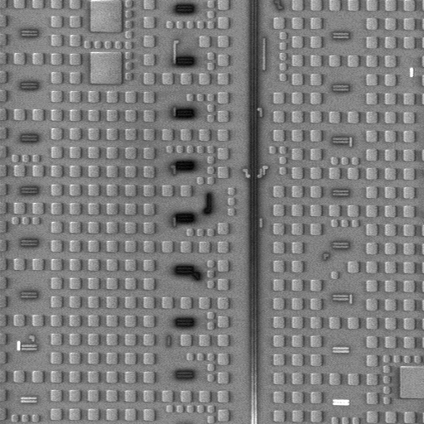
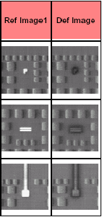
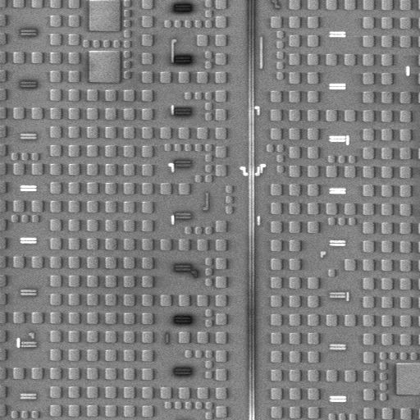
Stable Image? -- Stable GL
1st
5th
15th
30th
Case 2 – comparable charging/discharging rate
GL varies from scan to scan.
Charge up slowly, if paused, release quickly
Difficult to reach equilibrium, GL variation leads to false
Charge cannot hold after flooding
Sleep 15sec

Slide 26
DOI Check
Maximize VC on features of known electrical properties
Manipulate device for different DOI
Maximize grey level difference observed on different features
Search and optimize VC at potential DOI on Cell/Wafer edge
Search and optimize VC on dummy patterns
Optimize VC condition on real DOI

Slide 27
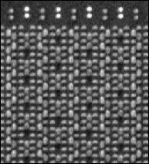
Based on Known Device
AT positive mode
P+/N-well forwarded biased by surface charging, plugs should be bright
N+/P-well reversely biased, plugs should be dark
Question your conditions if not the case
ISSM 2007 YE-O-030

Slide 28
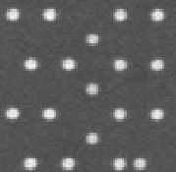
Maximum VC on Known Features
Known deep CT to P+/Nwell
Known deep CT land on gate
Gate CT can be treated as open, so expected to be darker than P+ plug at positive mode
question your conditions If not the case

Slide 29
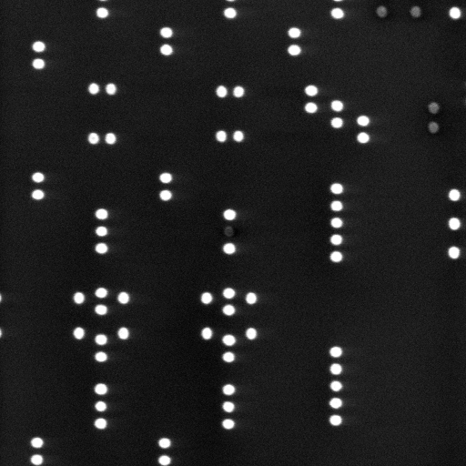
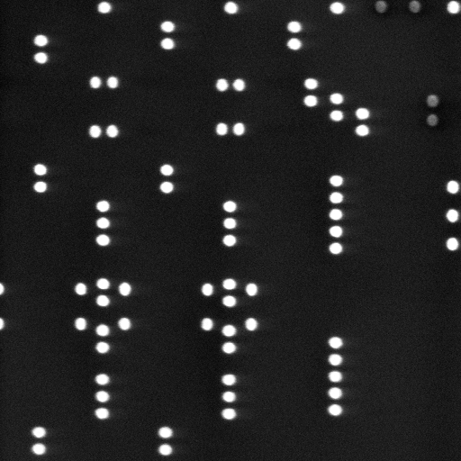
Maximum VC on Different Features
grey level differences on different features suggests electrical difference behind, this can be a reference for general condition tuning.

Slide 30
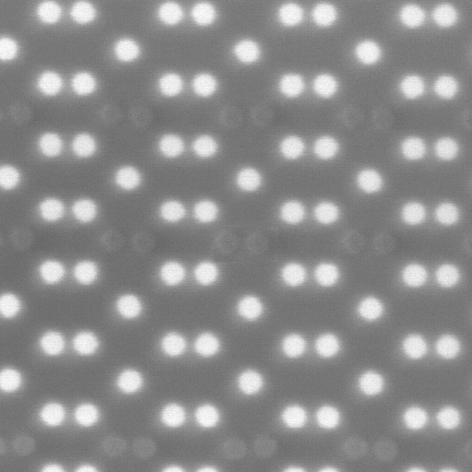
Maximum VC on Different Features
Most cases, customers have only interested on particular DOI, for instance only opens on SRAM, condition tuning direction should be changed accordingly.
Left image is sensitive to opens on both P and N plug, insensitive to leak on both plugs

Slide 31
Use Dummy Pattern as DOI
Dummy Pattern at cell edge equivalents to Open. Use it as a reference for DOI

Slide 32
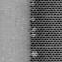

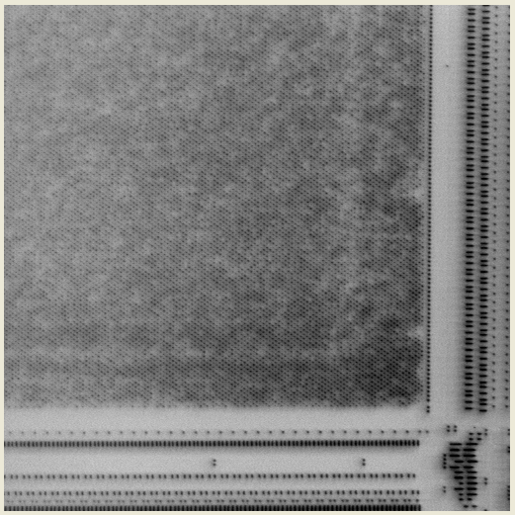
Search Cell/Wafer Edge for Possible DOI
Cell edge and/or wafer edge tends to have DOI
Search these locations for DOI, and optimize condition for better VC

Slide 33
Imaging Conditions
Wafer & Recipe Info
Topo Contrast
LE
Mat Contrast
Analyzing DOI
VC
Current
Testing Conditions
Good resolution
Pixel size
Stable
Average
General requirements
uniform
No.5 biasing
DOI check
On Device
On Dummies
Scan direction
Setup recipe & Test
On Edge Dice
Pre-scan
Tuning Condition
On DOI
Pre-Flood
Optimizing Insp
Threshold
Device status control
Sensitivity
Reviewing DOI
VC Balance
BGB
ADC/reporting
DBDB

Slide 34
Landing Energy
Trade off between resolution and material contrast
Lower edge contrast/res
Higher edge contrast/res
Higher material contrast
Lower material contrast
More positive charge
Towards negative charge
* In general cases for Material and Voltage contrast, edge signal should be controlled

Slide 35
Landing Energy
Charging (Effective SEY) control -> Positive or Negative

Slide 36
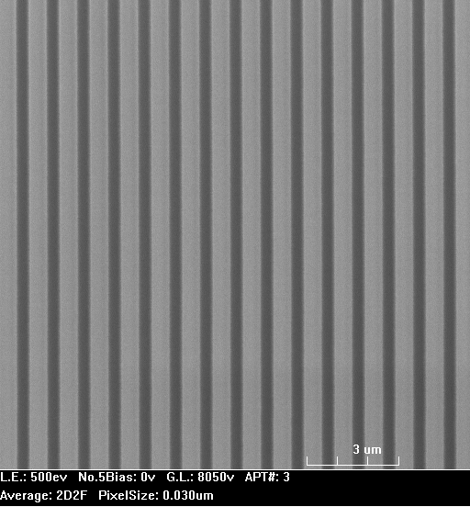

Landing Energy
Edge or Strip, Which you prefer ?

Slide 37




Landing Energy
Strong VC or none VC, Which you prefer ?
Without Cap
With Cap

Slide 38



Landing Energy
Positive Mode or Negative Mode, Which you prefer ?
Positive Mode
Pmos-On/Nmos-RBreak
Positive Mode
Pmos-Of/Nmos-on
Negative Mode
Pmos-On/Nmos-off
500ev/120nA -high Ip
800ev/30nA
1800ev/30nA

Slide 39
Beam Current
Charging control. Electron dose per image time -> charging rate
Reduce current

Slide 40


Beam Current
For annealed LPP, relatively wider charging rate applicable
400ev ~2-5nA, 1d8F
400ev 50nA, 1d8F

Slide 41


Beam Current
For non-annealed LPP, working charging rate is marginal to EBI
Reduce current
Too high for non-annealed
Small for non-annealed
Need to combined with other parameters for optimize VC:
1) Relative large pixel size; 2) scan perpendicular to piping; 3) positive pre-scan; 4) Dot average to reduce sampling; 5) frame average to cancel noise

Slide 42
Pixel Size
Pixel size too big to match Probe size
(a)
(b)
(c)

Slide 43




Pixel Size
Pixel size too big to resolve feature. The pattern is Moire effect
0.1um pixel
0.08um pixel
Pixel size matches feature size
0.05um pixel
0.025um pixel

Slide 44


Pixel Size
Case 1
Case 2
Total primary electron: Case 1 = Case 2
Image time Case 1 = Case 2
Image Area Case 1 = 4x Case 2
Dose intensity=total electron/area/time Case 1 = 0.25x Case 2
Charging rate Case 1 = 0.25x Case 2
Small pixel size not necessary to have better VC/sensitivity.

Slide 45


Average
DOT average
slow scanning, gives more time to dwell
enhanced charging rate, consistent to large current approaches
Less effective in canceling random noise;
1D
4D – Slow sampling rate is good

Slide 46

Test Scan Direction
N well
Trebuchet MS
Change scan direction to reduce charging rate through P+ to Nwell, so that VC difference enhanced

Slide 47

Test Scan Direction
Review image of Gate bridge
X-scan in large pixel reduces charging rate, less charge up make bridge appeared in VC
Y scan does not reveal the bridge in VC. Why? Y-scan charging rate too high, P+/N-well saturated and breakdown causes artifacts.
X-scan patch
Y-scan patch

Slide 48




Pre-Scan
Before pre-scan
After pre-scan
Pre-scan brings up sub-layer VC and transfers to surface

Slide 49
Pre-Scan
without pre-scan
After pre-scan
pre-scan achieve overall positive charge to boost Nmos leakage, thus open N+/Pwell contact standout as DVC

Slide 50
Test Pre-charging
Before flooding
After flooding
Via/trench in general need flooding
Flood enhances Contrast especially for via/trench

Slide 51
Thank You !!

